Slide 1
L6 Group 3 Ubisoft Design Masterclass
Tom Smith, Henry Hardy, Max Bovis

Slide 2
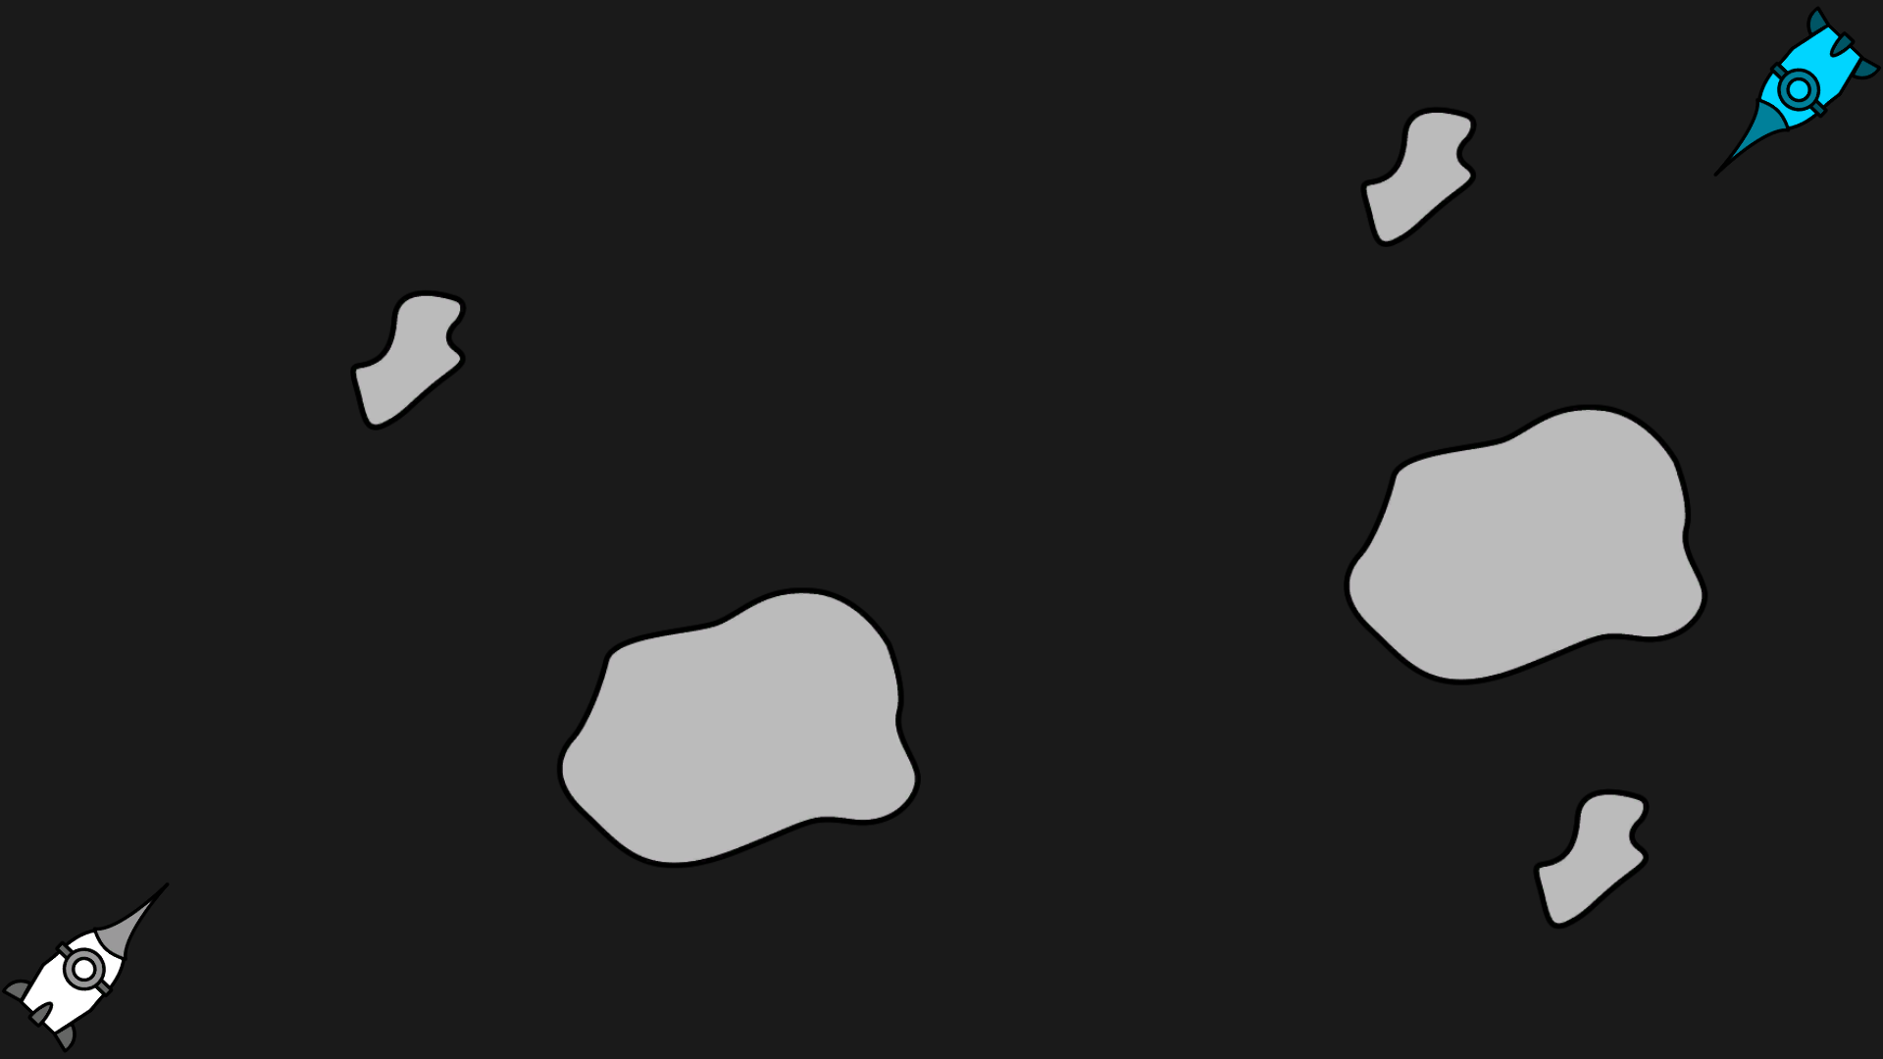
Prototype One
Cannot Control Rotation
Only add forward Momentum to your ship
2 – ? players

Slide 3
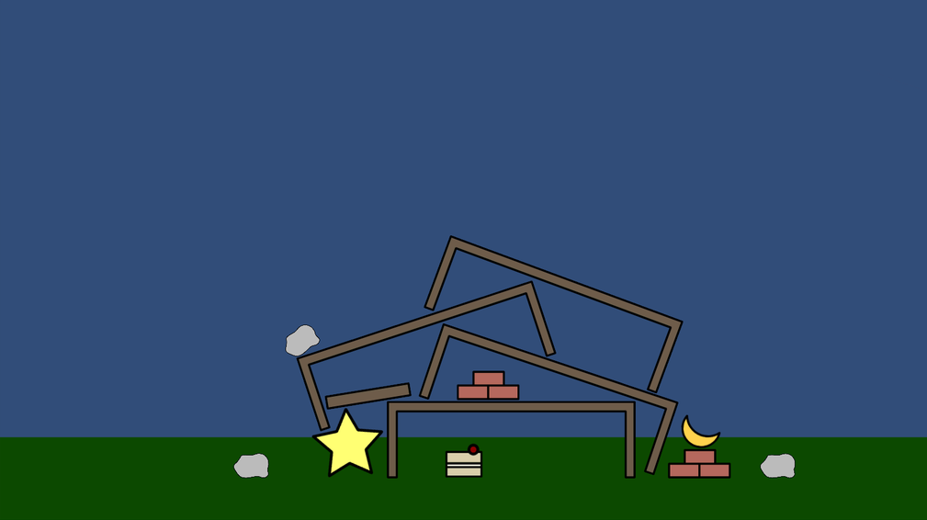
Prototype 2
Build a fort to protect your cake
Compete to grab resources for your fort.

Slide 4
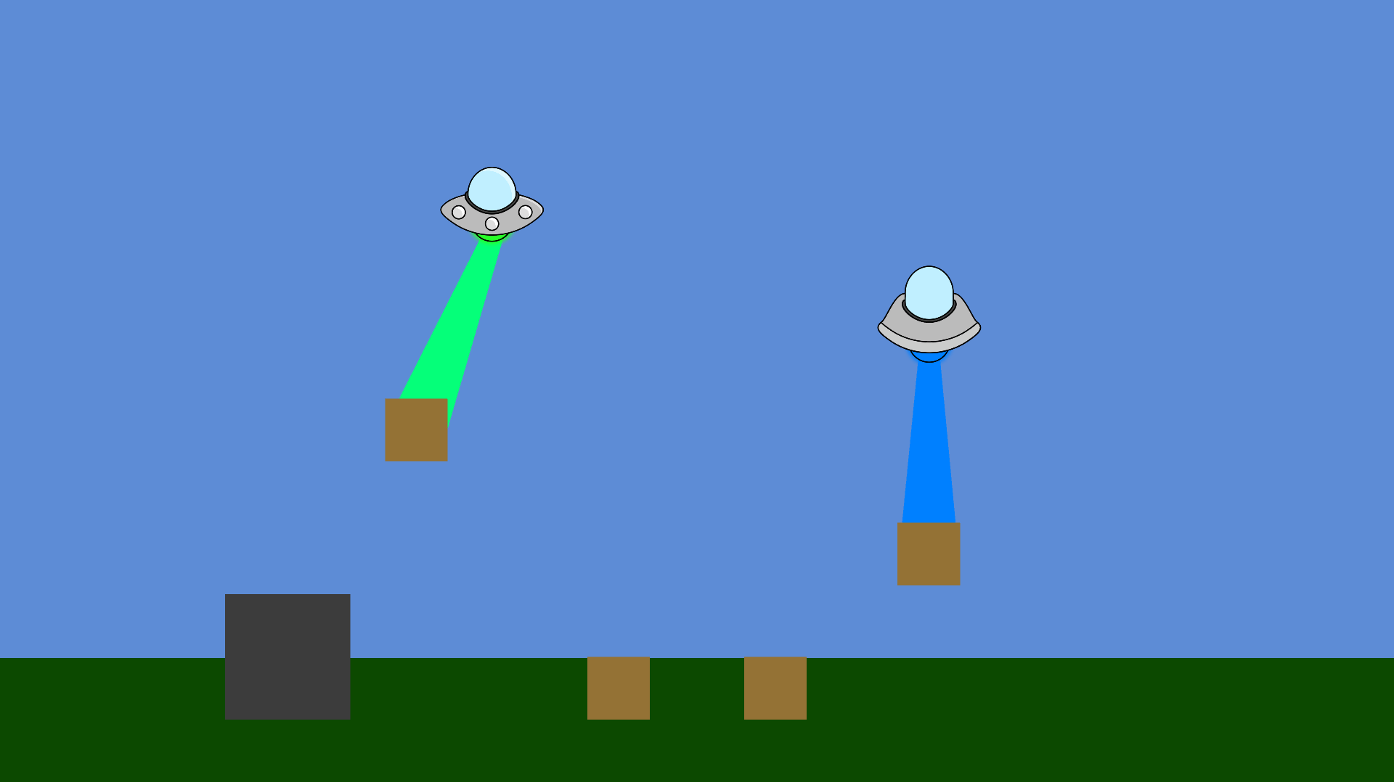
Prototype 3
Pick up objects of different weights
Swing them to gain momentum
Throw them at you opponent.

Slide 5
https://www.youtube.com/watch?v=f7jLtApmkQ4

Slide 6
What Next
Testing
Pick a Prototype and Iterate mechanic
More Testing
Polish (Art, sound, etc)
Even More Testing

Slide 7
Thank You For Listening Any Questions?

